Slide 1
Design of translation software with multi-inputs to translate English to Hindi OR vice-versa to prom
Submitted in the partial fulfillment for the award of the degree of
BACHELOR OF ENGINEERING
IN
AIML
Submitted by:
ANKIT KUMAR
ANIKET MITTAL
BIPANDEEP SINGH PANNU
AKSHIT JINDAL
Under the Supervision of:
MS LATA GUPTA
Department of AIT-CSE
DISCOVER . LEARN . EMPOWER

Slide 2
Outline
Introduction to Project
Problem Formulation
Objectives of the work
Methodology used
Results and Outputs
Conclusion
Future Scope
References

Slide 3
Introduction
In an age characterized by global interconnection and cross-cultural communication, the demand for seamless language translators has never been more pressing. The increase in international communication, business and collaboration highlights the need for efficient and contextually accurate translation between languages, especially between widely spoken languages ​​such as English and Hindi. This paper discusses the design of multi-input translation software with a focus on English-Hindi two-way translation. This work is motivated by the inherent challenges of existing translation systems, which often struggle to capture the complex nuances and contextual variations of these languages.

Slide 4
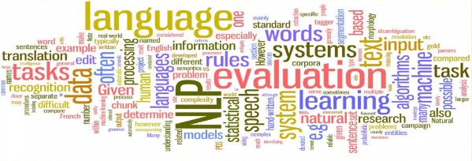
Natural Language Processing
Natural language processing (NLP) is a field of computer science,artificial intelligence, and computaional linguistics concerned with the interactions between computers and human (natural) languages.

Slide 5
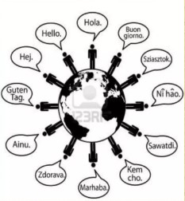
NLP APPLICATIONS
QUESTION ANSWERING.
TEXT CATEGORIZATION.
TEXT MINING.
MACHINE TRANSLATION.
SPELLING CORRECTION.

Slide 6
Problem Formulation
In machine learning translation, the problem formulation involves defining the task and objectives of the translation system. This typically includes determining the input and output formats, selecting appropriate training data, choosing a suitable model architecture, and deciding on evaluation metrics to assess the performance of the system. The goal is to design a machine learning model that can accurately translate text from one language to another.
In machine learning translation, the problem formulation is crucial for designing an effective translation system. Defining the task, selecting training data, choosing a model architecture, and determining evaluation metrics are all important steps in developing a machine learning model that can accurately translate text between languages. The ultimate goal is to create a system that achieves accurate and reliable translation results.

Slide 7
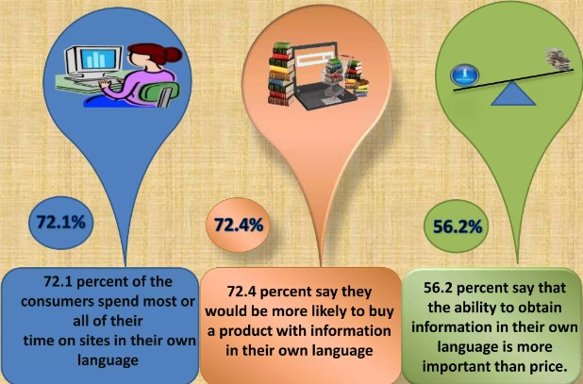
Objectives of the Work
The objectives of the project work on machine translation in NLP are to develop more accurate and efficient translation systems that can translate text and speech between languages, to improve the overall quality of translation output, and to advance the understanding of natural language processing and machine learning algorithms.

Slide 8
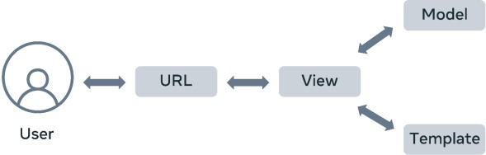
Methodology
Current machine translation systems are still not perfect and have several limitations. Additionally, machine translation systems can have difficulty translating text that is highly technical or specialized, as they may not have access to the necessary domain-specific knowledge. Finally, machine translation systems can be biased towards certain languages or cultures, which can lead to unfair or inaccurate translations.
Model, View and Template (MVT)

Slide 9
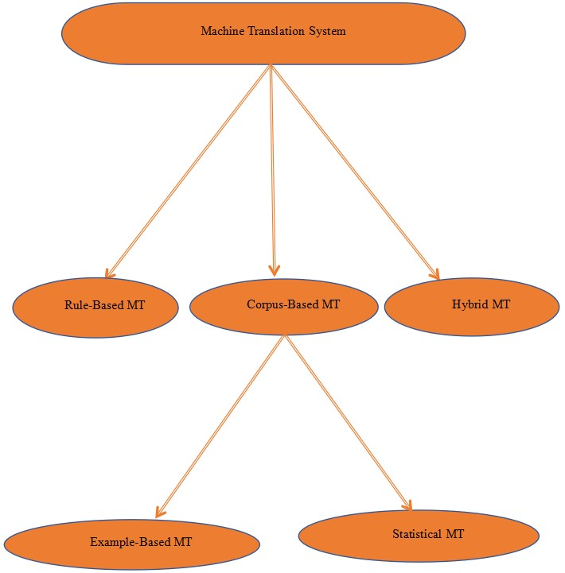
Machine translation is the use of artificial intelligence to automatically translate text from one language to another without human intervention. Modern machine translation goes beyond a simple word-for-word translation and conveys the full meaning of the original text in the target language.
Activity Diagram

Slide 10
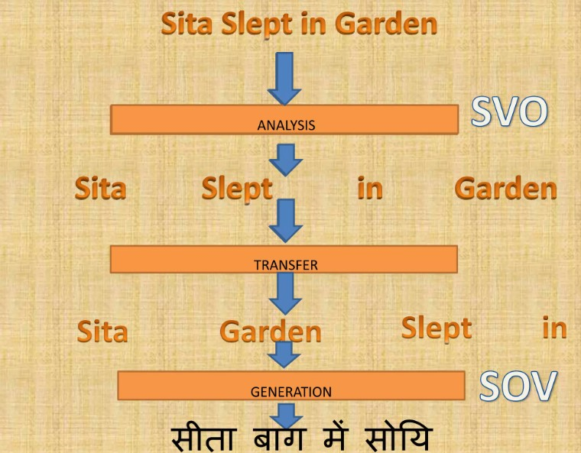
Rule Based Approach

Slide 11
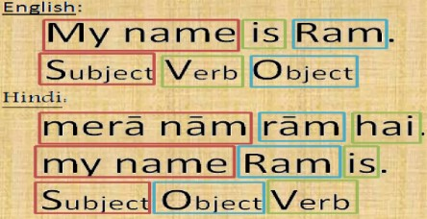
word order
Word order in language differs. Some classification can be done by naming the typical order of subject (s), verb(V) and object (O) in a sentence. Some languages have word orders as SOV. The target language may have a different word order. In such cases, word to word translation is difficult. For example, English language has SVO and Hindi language has SOV sentence structure.

Slide 12
Results and Outputs
Python virtual environment is a self-contained directory that encapsulates a specific Python interpreter and its associated libraries and packages. It allows you to create isolated environments for different Python projects, ensuring that the dependencies of one project do not interfere with those of another.
Python -m pip install --user virtualenv
Check the version of virtual environment to ensure it is installed properly
Python -m virtualenv –version
Now create a virtual environment named “myworld”
Python -m virtualenv myworld
To activate newly created environment, use the following command
source myworld/Scripts/activate

Slide 13
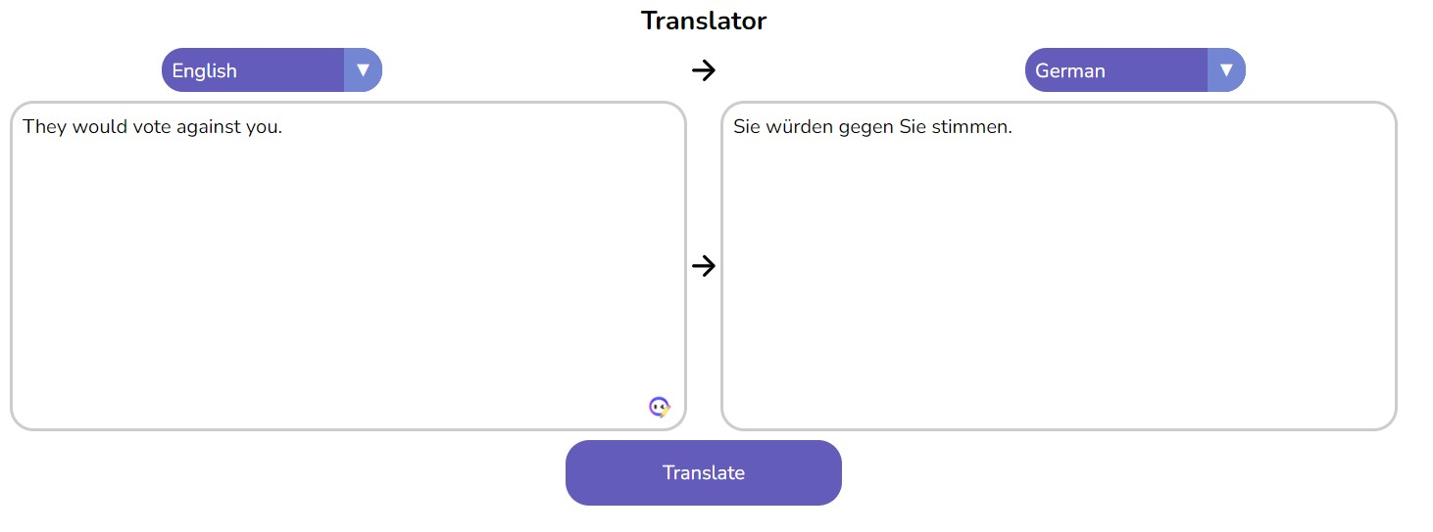
Inside view

Slide 14
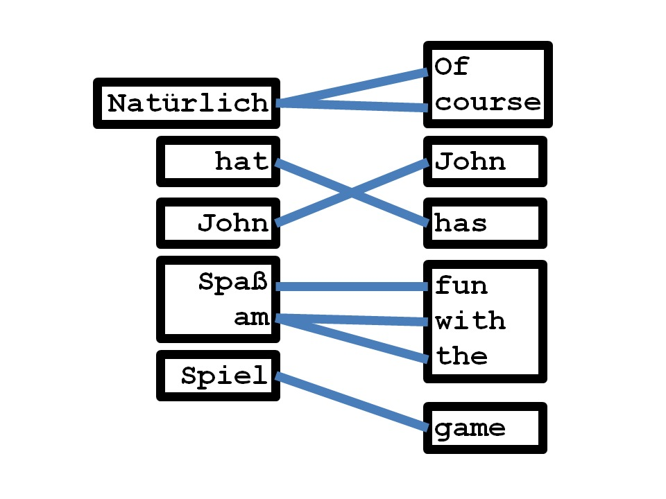
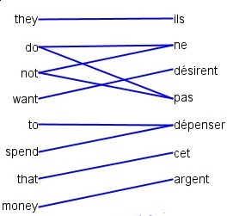
How the words are getting converted into other languages:

Slide 15
Example
Sie würden gegen Sie stimmen
They would vote against you
Rules:
Simultaneous generation of bilingual sentence pair through a sequence of operations
Generation is done in order of the target (English) sentence
Idea behind operations: either Translate or Reorder

Slide 16
Example
Sie würden gegen Sie stimmen
They would vote against you
Operations
o₁: Generate (Sie – They)
Sie
They

Slide 17
Example
Sie würden gegen Sie stimmen
They would vote against you
Operations
o₁ Generate (Sie, They)
o₂ Generate (würden, would)

Slide 18
Example
Sie würden gegen Sie stimmen
They would vote against you
Operations
o₁ Generate (Sie, They)
o₂ Generate (würden, would)
o₃ Insert Gap
Sie würden
They would

Slide 19
Example
Sie würden gegen Sie stimmen
They would vote against you
Operations
o₁ Generate (Sie, They)
o₂ Generate (würden, would)
o₃ Insert Gap
o₄ Generate (stimmen, vote)
Sie würden stimmen
They would vote

Slide 20
Example
Sie würden gegen Sie stimmen
They would vote against you
Operations
o₁ Generate (Sie, They)
o₂ Generate (würden, would)
o₃ Insert Gap
o₄ Generate (stimmen, vote)
o₅ Jump Back (1)
Sie würden stimmen
They would vote

Slide 21
Example
Sie würden gegen Sie stimmen
They would vote against you
Operations
o₁ Generate (Sie, He)
o₂ Generate (würde, would)
o₃ Insert Gap
o₄ Generate (stimmen, vote)
o₅ Jump Back (1)
o₆ Generate (gegen, against)
o₇ Generate (Sie, you)
Sie würden gegen Sie stimmen
They would vote against you

Slide 22
Model
Joint probability model over operation sequences
Sie würden stimmen gegen
<GAP> <Jump Back> Sie
They would vote against you
o₁ o₂ o₃ o₄ o₅ o₆ o₇
Context window: 9-gram model

Slide 23
Django:
Django is a high-level Python Web framework that encourages rapid development and clean, pragmatic design. Built by experienced developers, it takes care of much of the
Machine learning translators use artificial intelligence to translate text from one language to another. They are trained on large amounts of data, such as parallel corpora, which consist of texts that have been translated by humans. The training process involves feeding the data into the model and adjusting the model's parameters so that it learns to translate text accurately.

Slide 24
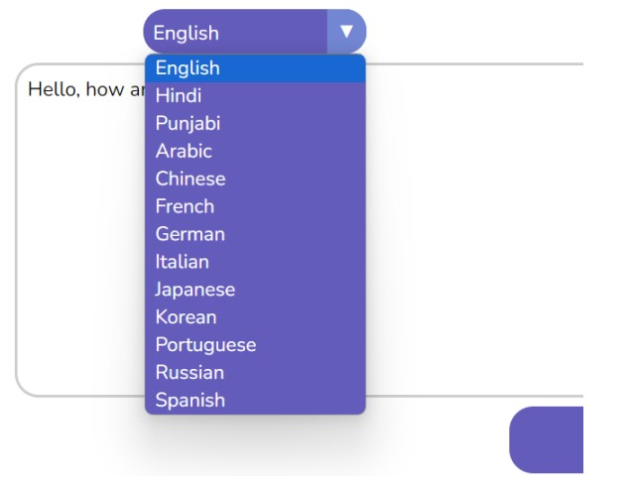
Mutliple Languages
The code is running successfully, As you can see there are multiple options for selecting the language
We can translate into many languages with just click of a button in very less time.

Slide 25
Conclusion
Conclusions of Hindi-English Machine Translation Project Machine translation (MT) is the process of automatically translating text from one language to another. Hindi-English MT is a challenging task due to the significant differences between the two languages in terms of grammar, vocabulary, and syntax.
However, in recent years, there has been significant progress in Hindi-English MT, thanks to advances in deep learning and the development of large language models.
One of the key findings of our project was that the performance of Hindi-English MT models is highly sensitive to the domain of the text being translated. For example, models trained on news data performed significantly better on news articles than on general-purpose text. This suggests that it is important to develop domain-specific MT models in order to achieve the best possible results.

Slide 26
Future Scope
We recommend the following directions for future research in Hindi-English MT: Develop domain-specific MT models for different domains, such as news, business, and government. Explore the use of deep learning techniques to improve the performance of post-editing systems. Develop new MT models that are more robust to noise and errors in the input text. Develop new MT models that can translate between Hindi and English dialects.
Improving the performance of MT models: This includes developing new MT models that are more accurate, robust, and efficient. It also includes developing methods to improve the performance of existing MT models, such as through transfer learning and domain adaptation.

Slide 27
References
[1] P. K. Go swami and S. K. Dewedi, “An empirical study on English to Hindi e-contents machine translation through multi engines,” in Reliability, Info com Technologies and Optimization (ICRITO)(Trends and Future Directions), 2014 3rd International Conference on. IEEE, 2014, pp. 1–6.
[2] N. Sharma, “English to Hindi statistical machine translation system,” PhD.D. dissertation, THAPAR UNIVERSITY PATIALA, 2011.
[3] P. F. Brown, J. Coke, S. A. D. Petra, V. J. D. Petra, F. Jetliner, J. D. Afferent, R. L. Mercer, and P. S. Rossini, “A statistical approach to machine translation,” Computational linguistics, vol. 16, no. 2, pp. 79– 85, 1990.
[4] H. Comers, “Review article: Example-based machine translation,” Ma- chine Translation, vol. 14, no. 2, pp. 113–157, 1999.

Slide 28
[5] J. Clienteles and M. R. Coats-Jussive, “Chinese-to-Spanish rule-based machine translation system,” 2014.
[6] D. Groves and A. Way, “Hybrid data-driven models of machine trans- lation,” Machine Translation, vol. 19, no. 3-4, pp. 301–323, 2005.
[7] B. Hyacinth and S. Joseph, “A hybrid approach to English to Malayalam machine translation,” International Journal of Computer Applications, vol. 81, no. 8, 2013.
[8] B. J. Dour, “Machine translation divergences: A formal description and proposed solution,” Computational Linguistics, vol. 20, no. 4, pp. 597– 633, 1994

Slide 29
[9] R. Sin ha and A. Thar, “Disambiguation of Hindi to English machine translation,” in Sixth International Conference of South Asian Languages (ICOSAL-6), 2005.
[10] D. Marci, “Towards a unified approach to memory-and statistical-based machine translation,” in Proceedings of the 39th annual meeting on as- association for computational linguistics. Association for Computational Linguistics, 2001, pp. 386–393.

